Slide 1

ONLINE HOTEL
ROOM BOOKING
This system streamlines hotel operations, providing a centralized platform for managing guests, rooms, finances, and staff. It offers an array of features to enhance efficiency and guest satisfaction.
Roshni Prabakar(192211823)
Rohitha.G (192210242)

Slide 2
Introduction:
Managing hotels manually can cause problems like errors, delays, and a poor guest experience. To fix these issues, we developed an “Online Hotel Management System”, which is a smart, web-based platform designed to streamline hotel operations and improve efficiency. Managing consumer data without automation is time-consuming and vulnerable to security breaches.
The Hotel Management System project tackles these essential concerns by providing a comprehensive, automated, web-based solution for streamlining hotel operations guaranteeing that activities are seamless and efficient. Guests may instantly book, check room availability, and manage their reservations, all of which contribute to a smooth user experience. Furthermore, the system improves data quality and security, guaranteeing that client information is handled carefully and preserved securely.
This system not only makes hotel operations smoother but also allows staff to focus on providing better service while guests enjoy a hassle-free experience.
The web-based nature of the solution also means that it is accessible from anywhere, at any time, providing convenience for both guests planning their stay and hotel managers overseeing operations.

Slide 3
Here's what it offers:
- Simplifies Hotel Operations:
Automates tasks like room bookings, availability checks, and reservation management.
- Improves Guest Experience:
Guests can book rooms quickly, check availability, and manage their stay with ease.
- Reduces Errors:
Automation reduces human mistakes, like double bookings or incorrect details.
-Enhances Security:
Protects customer data with secure storage and handling.
- User-Friendly Design:
Simple for both guests and hotel staff to navigate and use.
- Accessible Anywhere:
Being web-based means it works from any location at any time.

Slide 4
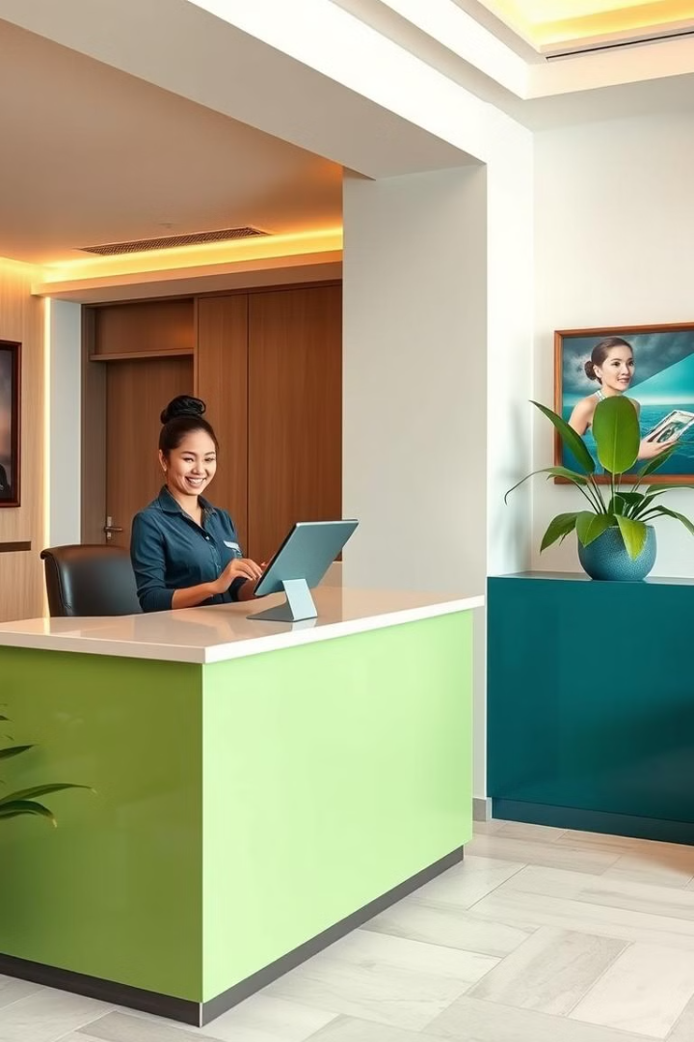
Guest Booking and Reservations
1
Online Booking
Guests can make reservations online through the hotel's website or a travel booking platform.
2
Reservation Management
The system tracks reservations, guest information, and room availability.
3
Check-in and Check-out
The system facilitates smooth check-in and check-out procedures, minimizing waiting times.
4
Guest Communication
The system enables communication with guests, providing updates and personalized messages.

Slide 5
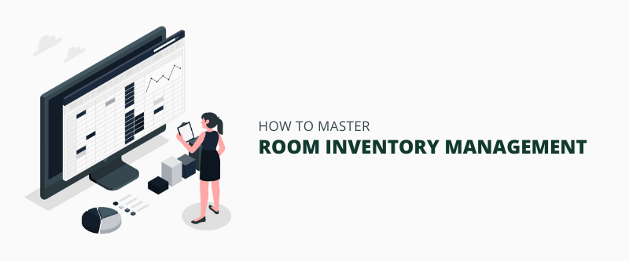
Room Management and Inventory
Housekeeping Management
Room Availability
Room Types and Rates
The system displays real-time room availability, allowing staff to manage room allocation effectively.
The system manages different room types and their associated rates, enabling flexible pricing strategies.
The system tracks room status and assigns housekeeping tasks, ensuring cleanliness and guest satisfaction.

Slide 6
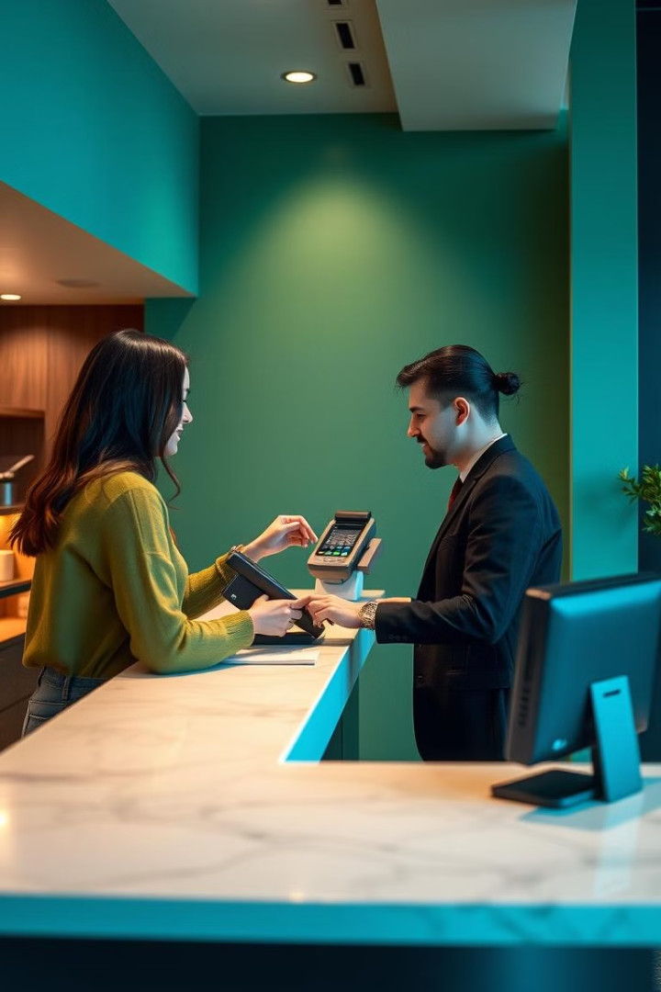
Billing and Payments
Guest Charges
Payment Processing
1
2
The system records all charges incurred by guests, including room rates, meals, and amenities.
The system supports multiple payment methods, including credit cards, debit cards, and cash.
Billing Statements
Financial Reporting
3
4
The system generates detailed billing statements for guests, outlining their expenses.
The system provides comprehensive financial reports, tracking revenue, expenses, and profitability.

Slide 7
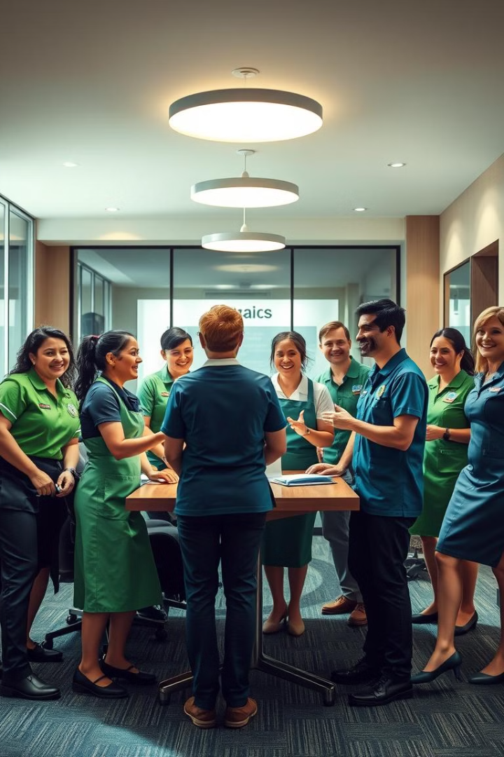
Staff and Housekeeping Management
Staff Scheduling
Employee Information
The system helps manage staff schedules, ensuring adequate coverage for all departments.
The system stores employee details, including contact information, skills, and performance records.
Task Assignment
Performance Monitoring
The system allows managers to assign tasks to staff members, improving organization and efficiency.
The system tracks staff performance, enabling managers to identify strengths and areas for improvement.

Slide 8
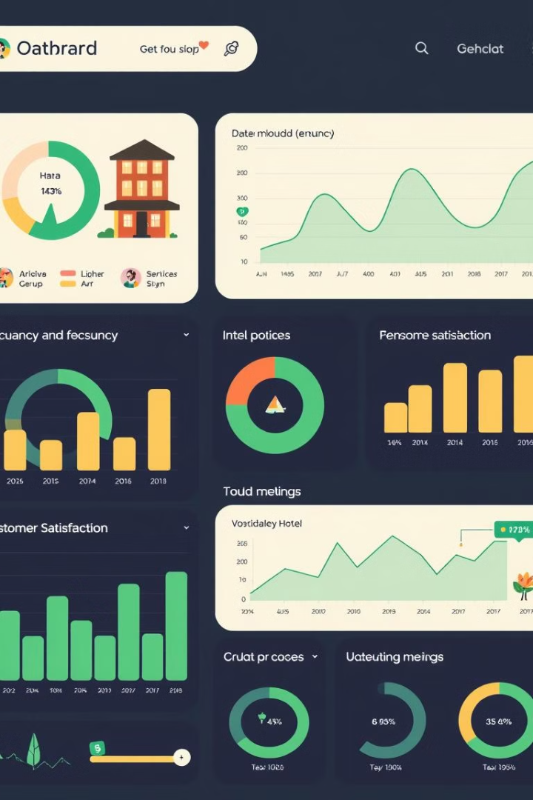
Reporting and Analytics
Occupancy Rates
Track room occupancy and identify trends.
Revenue Analysis
Analyze revenue streams and profitability.
Customer
Feedback
Monitor guest satisfaction and identify areas for improvement.
Staff
Performance
Evaluate staff performance and identify areas for training.

Slide 9
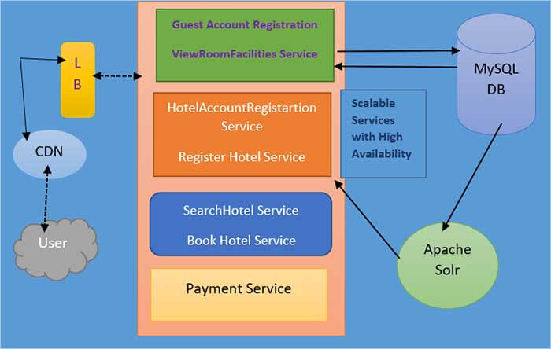
Architectural Diagram

Slide 10
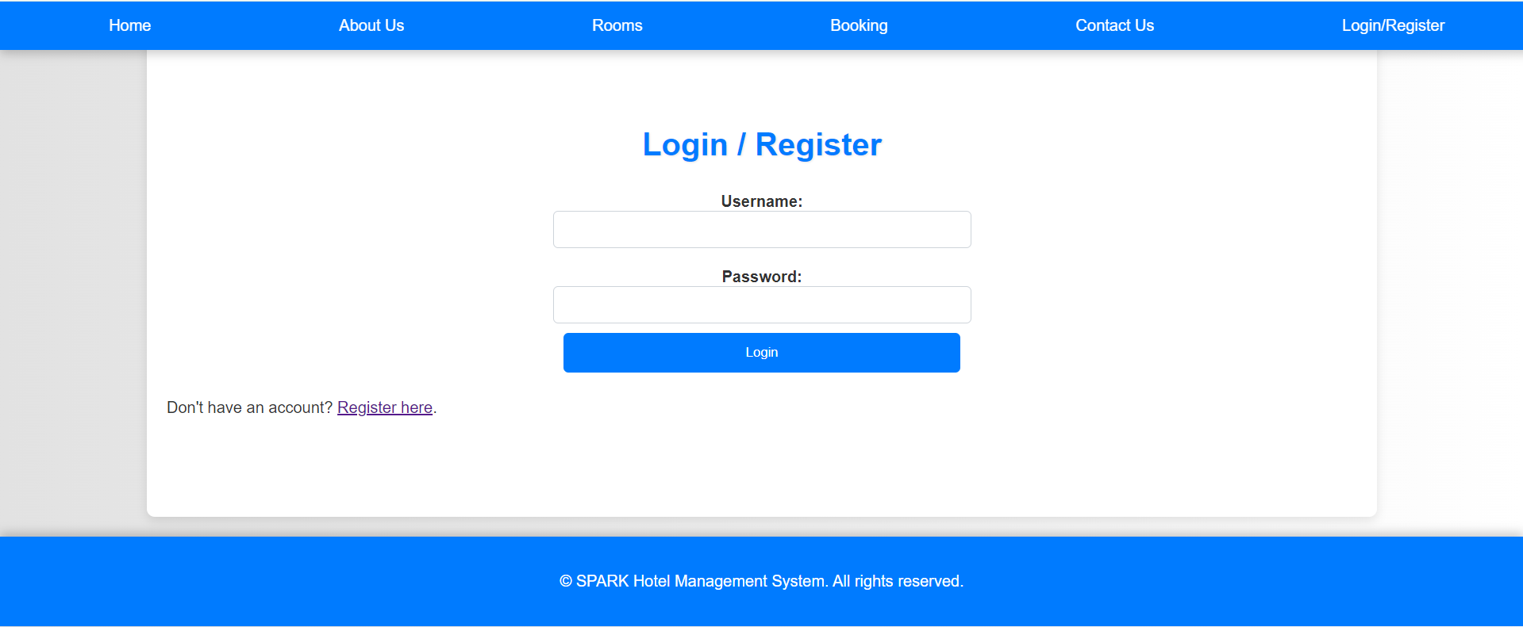
Screenshots

Slide 11
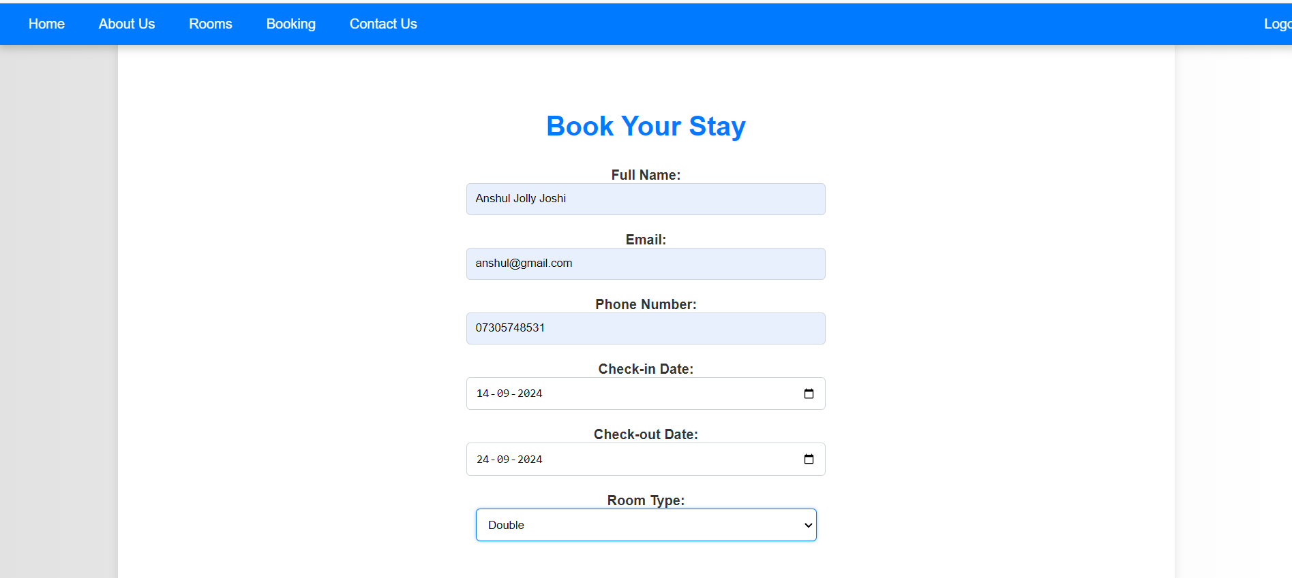

Slide 12
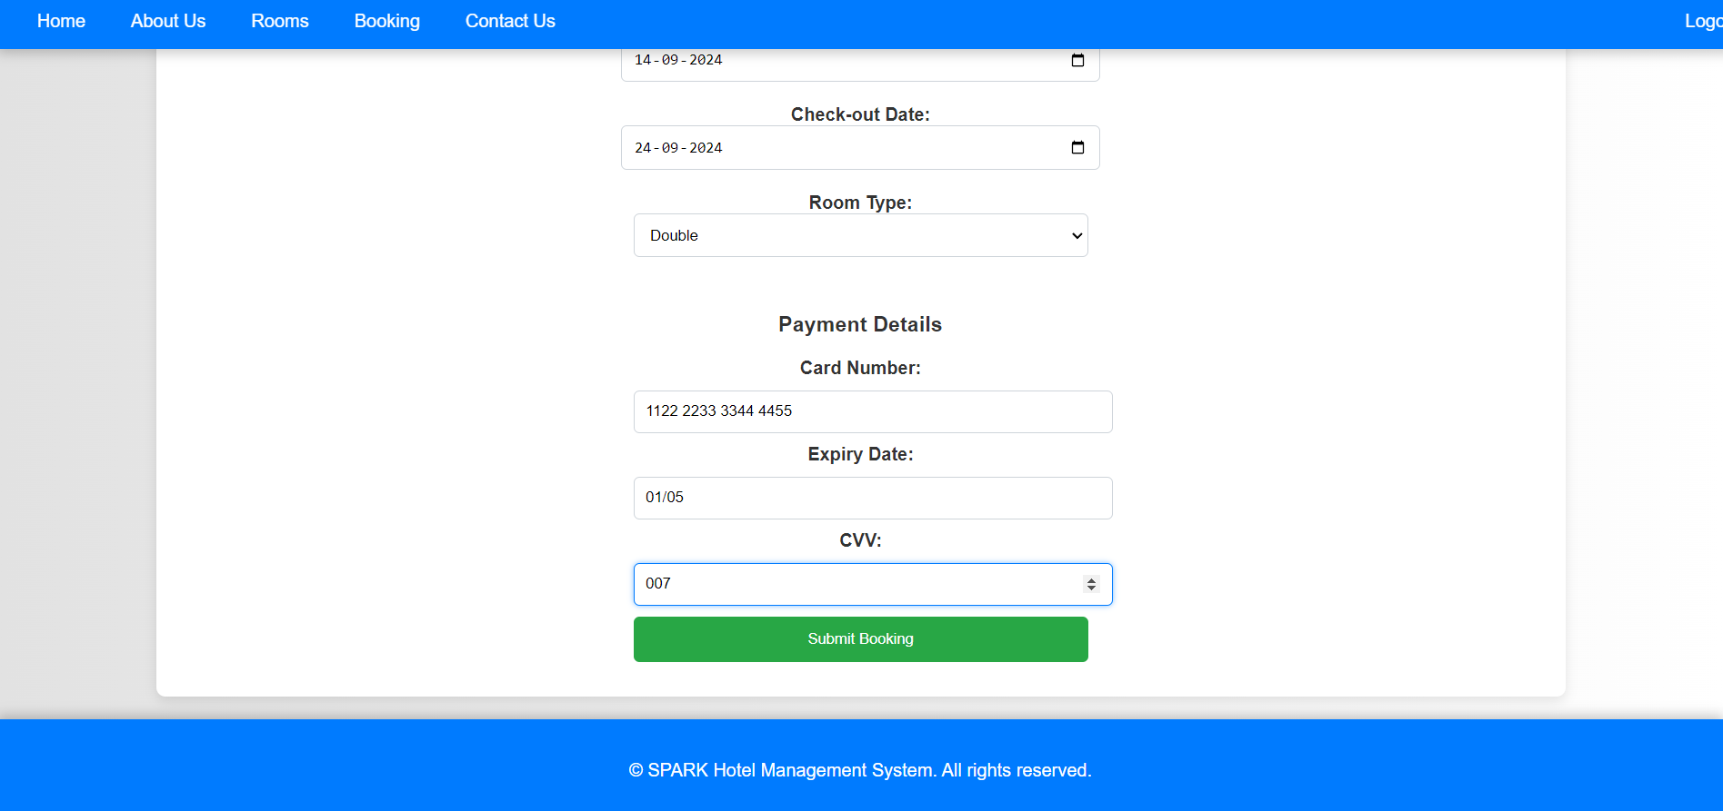

Slide 13
CONCLUSION
The Online Hotel Room Booking project successfully automates the process of managing hotel bookings and user data, offering a streamlined and efficient solution for the hospitality industry. By leveraging a combination of advanced web technologies, the system significantly improves operational efficiency, reduces the likelihood of errors, and enhances the overall guest experience. The automation of these processes means that hotel staff can dedicate more time to providing high-quality service to guests rather than dealing with tedious administrative tasks. This project demonstrates the effective use of HTML, CSS, JavaScript, PHP, and MySQL in developing a comprehensive, user-friendly web-based application.
In summary, the Hotel Management System project is a testament to the power of modern web technologies in solving real-world problems. By automating the management of hotel bookings and user data, the system not only improves efficiency and reduces errors but also significantly enhances the overall guest experience. The effective use of HTML, CSS, JavaScript, PHP in this project highlights the potential of these technologies to create comprehensive, reliable, and user-friendly web applications that meet the needs of the hospitality industry.

